Slide 1
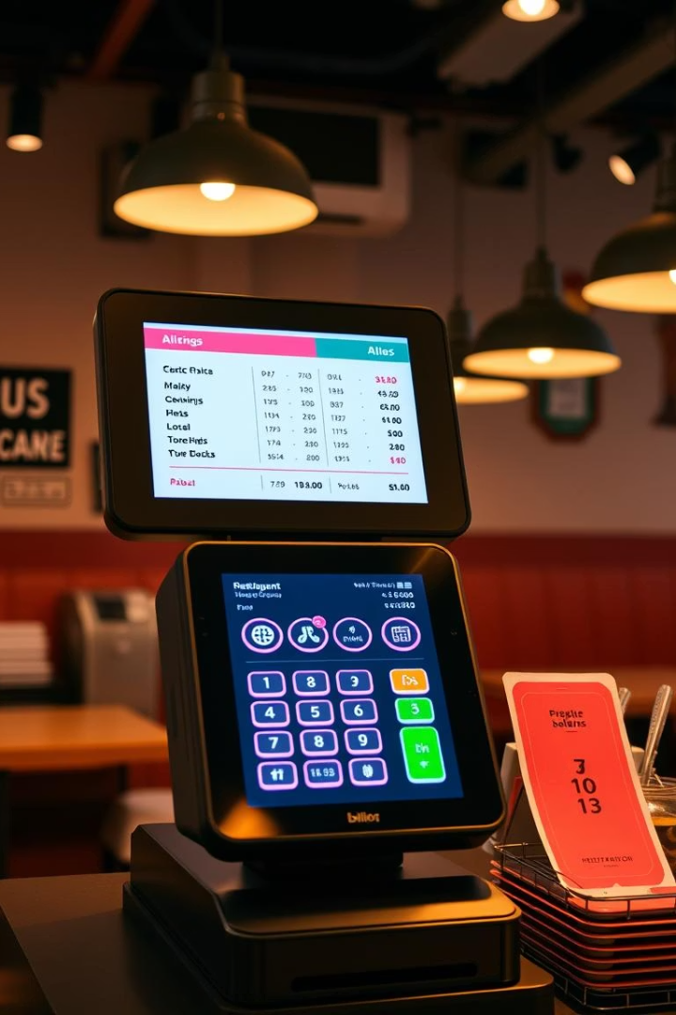
Restaurant Billing
System Project
Name Roll No.
Ishaan Hingway 08 Tanisha Nakate 09
Abhishek Palase 17
Shubham Pattewar 18
Simoni Sawant 23

Slide 2
Project Overview
This project develops a GUI-based Restaurant Billing System. It enables users to generate bills easily and save receipts digitally. Let’s explore the objectives, architecture, and working of this Java Swing application.
The system calculates total costs from selected food items quantities.
GST is applied automatically with bill saving options included.
Developed using Java Swing and AWT components for GUI.

Slide 3

Key Objectives
GUI Programming
Learn interactive interface creation with Java Swing.
Billing Simulation
Build a functional restaurant billing calculator.
File Operations
Implement saving generated bills as text documents.
Event-Driven Design
Apply modular code with action listeners and handlers.

Slide 4



System Architecture Layers
2
Business Logic
Price calculations, tax, bill formatting, display logic.
User Interface
JFrame, JPanel, JLabel, JButton, and layout managers.
1
Persistence
File writing using FileWriter and BufferedWriter for saving bills.
3

Slide 5
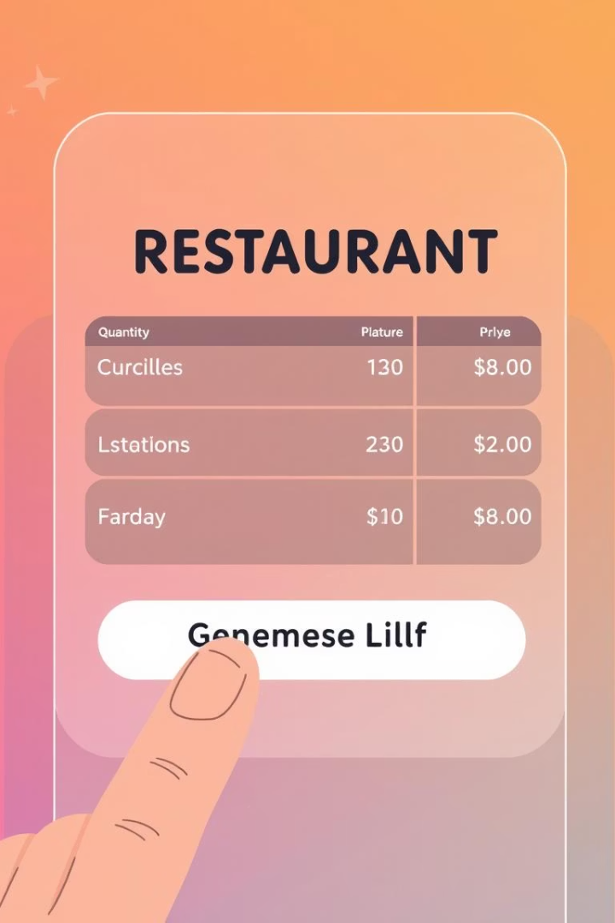




System Workflow
Input Quantities
User enters pizza, burger, cold drink amounts.
Generate Bill
System calculates subtotal, 5% tax, and total cost.
Display Bill
Formatted bill with date/time appears in text area.
Save or Reset
Save bill as text file or reset inputs to start again.

Slide 6
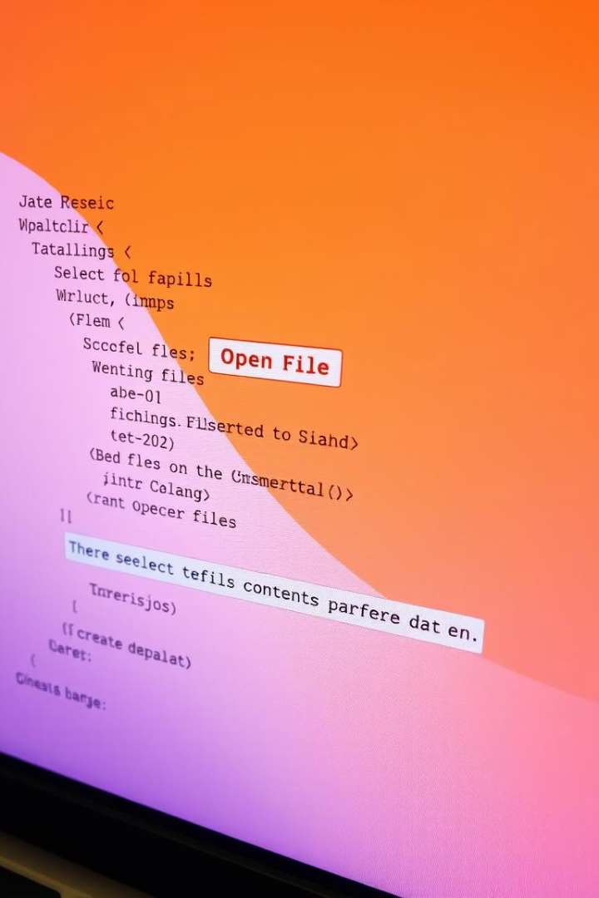
Java Concepts Used
Swing Components
JFrame, JPanel, JTextField, JButton, JTextArea, JScrollPane.
Event Handling
ActionListener and actionPerformed method for responding to clicks.
Layout Managers
BorderLayout, GridLayout, FlowLayout organize the interface.
File & String Handling
Use FileWriter, BufferedWriter; format currency with String.format().

Slide 7
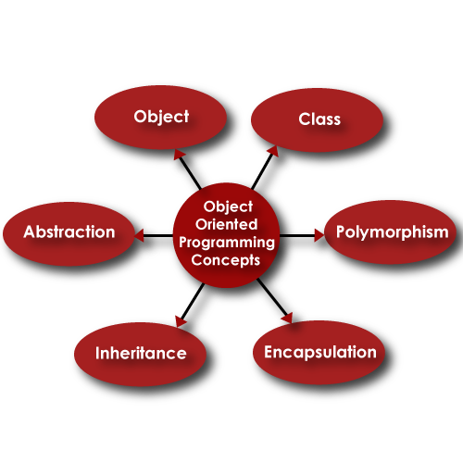
Object-Oriented Techniques
Project follows OOP fundamentals with class-based structure. Data encapsulation ensures modular and maintainable code. Event-driven programming models user interactions effectively.
This approach enhances code readability and extensibility for future upgrades.

